Slide 1




SAI VIDYA INSTITUTE OF TECHNOLOGY
RAJANUKUNTE, BENGALURU - 560119
DEPARTMENT OF COMPUTER SCIENCE AND ENGINEERING
Cryptography and Network Security(BCS703)
Case Study On
“Secure E-Commerce Transactions”
Team No: 5
Presented By:
LEKHANA S B 1VA23CS087
M ASHOKA 1VA23CS088
M SAHANA 1VA23CS089
MADHUKESH S 1VA23CS090
Course Coordinator:
Dr. Vinod Desai
Associate Professor
Dept. of CSE,
SVIT

Slide 2


Contents
Introduction to Case Study
Problem Statement
Objectives
Crytographic techniques/algorithms used
Proposed Solution
System/Implementation Details
Results and Discussion
Conclusion
References

Slide 3
Introduction
Sensitive data travels over the public internet:
Online shopping exposes card numbers, CVV, and personal details to attackers on the same network. Protecting this data is a core e-commerce requirement .
Payments face many realistic attack types:
Attackers can eavesdrop to steal card details, secretly change the amount or items, impersonate a genuine customer, replay old payments, or swap a UPI QR code to redirect money to themselves.
SecurePay protects the payment at every step:
It is a working secure-checkout prototype: customer orders are digitally signed to guarantee origin and content, then encrypted so only the payment gateway can read them. It supports card payments with bank-style validation and UPI payments with tamper-proof QR codes.
The project proves security instead of only claiming it:
An Attack Lab launches six realistic attacks: eavesdropping, tampering, forgery, impersonation, replay, and QR swapping and shows each one being blocked by a specific control.

Slide 4
Problem Statement
"Protect customer payment information and transaction details from cyberattacks during online shopping."
Online shoppers send sensitive data card numbers, CVV, and personal details over public networks they do not control, exposing them to attacks. An attacker can eavesdrop, alter the amount or items, impersonate the customer, replay an old payment to charge twice, or swap a UPI QR code to redirect funds. Such attacks are hard for users to notice because a tampered payment can look genuine.
The system must guarantee five properties at once: confidentiality (only the gateway can read data),integrity(any change is detected), authenticity(the order truly came from the customer), non-repudiation(the customer cannot deny it), and replay protection(old payments cannot be reused).

Slide 5
Objectives
Build a complete secure checkout prototype
Develop a working end-to-end e-commerce flow customer sign-up, shopping, cart, checkout, and payment gateway where the entire transaction is protected by real, industry-standard cryptography
Guarantee the five security goals in one system.
Ensure every transaction provides confidentiality, integrity, authenticity, non-repudiation, and replay protection at the same time, so no single attack reading, tampering, impersonating, or replay can succeed alone.
Support both major payment rails safely.
Implement card payments with live card validation and bank-style authorization and by UPI payments with signed tamper evident QR code, showing that the same security model protects both ends
Prove the protection by attacking it.
Launch realistic attacks :eavesdropping ,tampering, forgery, impersonation, replay, and QR-swapping and demonstrate that each one is detected and blocked by a specific cryptographic control.

Slide 6
Techniques/Algorithms Used
Hybrid Encryption — AES-256 + RSA-2048 (OAEP).
Order is encrypted with a fresh AES-256 key and that AES key itself is locked with the gateway's RSA public key so only the gateway can unlock it .This provides confidentiality even a captured payment stays unreadable.
Digital Signature — RSA-PSS with SHA-256.
The customer signs the order with their private key before sending it. The gateway verifies the signature with the customer's public key, proving the order is genuine and untouched. This provides authenticity and non-repudiation the customer cannot deny the payment.
Integrity Checks — SHA-256 and HMAC-SHA256.
A SHA-256 hash of the payload gives a tamper-evident fingerprint of the order, and an HMAC-SHA256 seal protects the payment token. If an attacker changes even one byte, the checks fail and the payment is rejected providing integrity and replay detection
Safe Storage & Card Validation — PBKDF2 + Luhn.
passwords are never stored only salted PBKDF2 hashes (200,000 iterations), so even the database leaks no passwords. At entry, every card number is verified with the Luhn checksum before the simulated bank authorizes the payment.

Slide 7
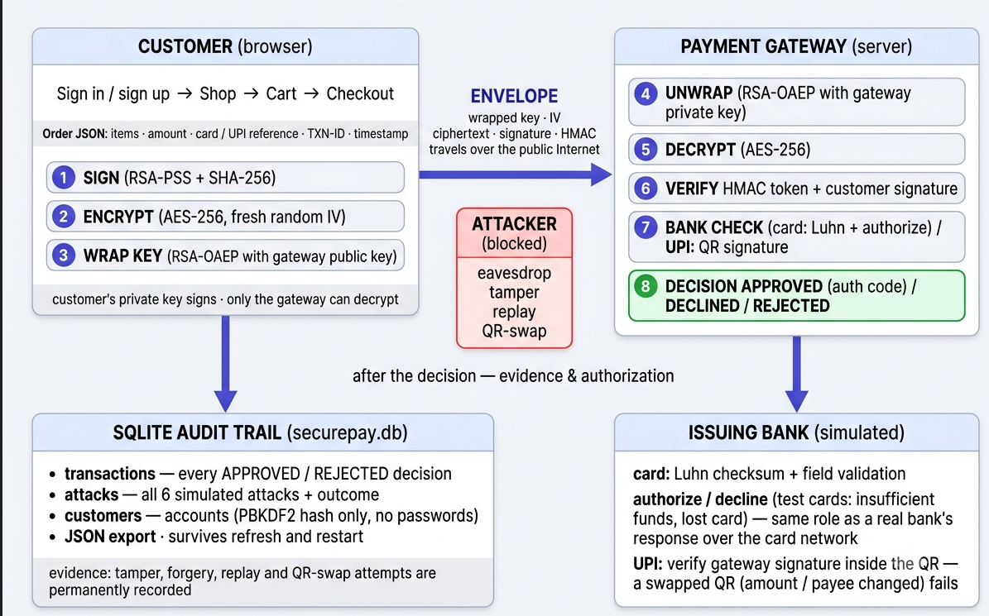
Proposed Solution

Slide 8
Proposed Solution
Protect the order with a signed, sealed envelope.
When the customer pays, the entire order is first digitally signed proving who sent it and that it wasn't changed and then encrypted so that only the payment gateway can read it. The AES key used for encryption is itself locked inside the gateway's public key, so even if an attacker captures the whole payment on the network, all they see is unusable ciphertext.
Support real payments on two rails.
The checkout accepts both major payment methods: card , where the number is validated in real time (checksum, network, expiry) and authorized by a simulated issuing bank before processing; and UPI, where the merchant's payment request is digitally signed and rendered as a QR code so a tampered or swapped QR is detected instantly, defending against real-world QR fraud.
Verify at the gateway, prove it with evidence.
The gateway unwraps and decrypts the payment, verifies every seal, and only then approves the transaction rejecting anything that fails any check. An Attack Lab launches realistic attacks against this live system and shows each one being blocked by a named protection, while a permanent database records every transaction.

Slide 9
Implementation
Clean Python architecture
Built in Python 3.11 as a modular securepay package, separating cryptographic logic (crypto.py), payment flows (flow.py), and storage (db.py) from the Streamlit UI screens in app_pages/.
Real cryptography with per-session keys.
Implemented using PyCryptodome with AES-256, RSA-2048, RSA-PSS, SHA-256, and HMAC. Fresh RSA keypairs are generated every session, and each transaction gets a unique AES key and IV no secrets are ever reused or stored on disk.
Thread-safe SQLite audit layer.
Logs every gateway decision, attack attempt, and user account (using salted PBKDF2 hashes only passwords are never stored). The trail survives app restarts and supports JSON export for inspection.
Real-Time Encryption Visibility
Streamlit UI displays customer data and the encrypted wire format side-by-side, making encryption visible in real time.

Slide 10
Results
. The full payment flow succeeds end to end.
A complete transaction sign-up, shopping, checkout, and gateway verification runs in real time. The order is signed, encrypted, and approved with an authorization code, while the wire view confirms only ciphertext is visible, never card details.
Every attack is detected and blocked
All six simulated attacks fail against the live system: bit-flipped ciphertext and forged HMACs fail integrity checks, forged signatures fail verification, wrong private keys cannot unwrap the AES key, replayed envelopes are refused via transaction ID, and swapped UPI QRs fail signature checks.
The results show why layered security matters.
No single algorithm carries the whole burden: encryption hides data, signatures prove origin, HMACs catch tampering, and transaction IDs stop replay. Cards protect the data itself, while UPI protects the authenticity of the request.

Slide 11
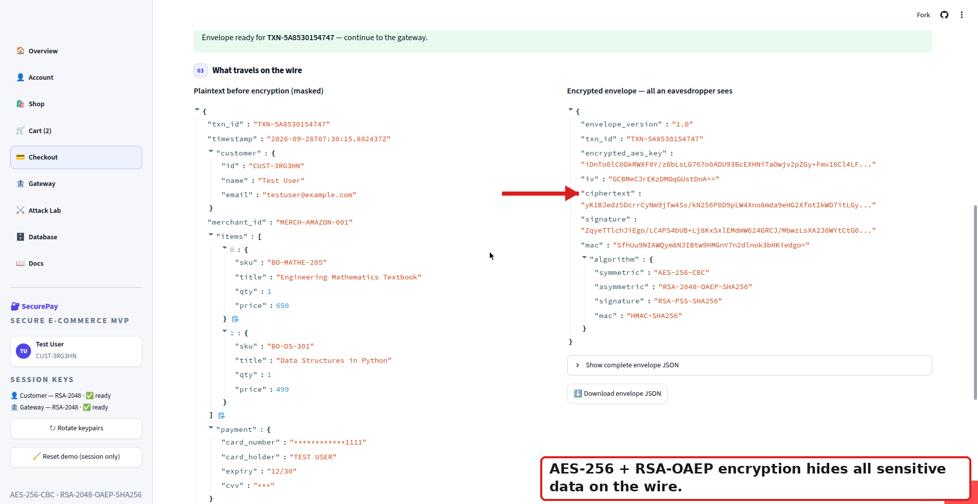
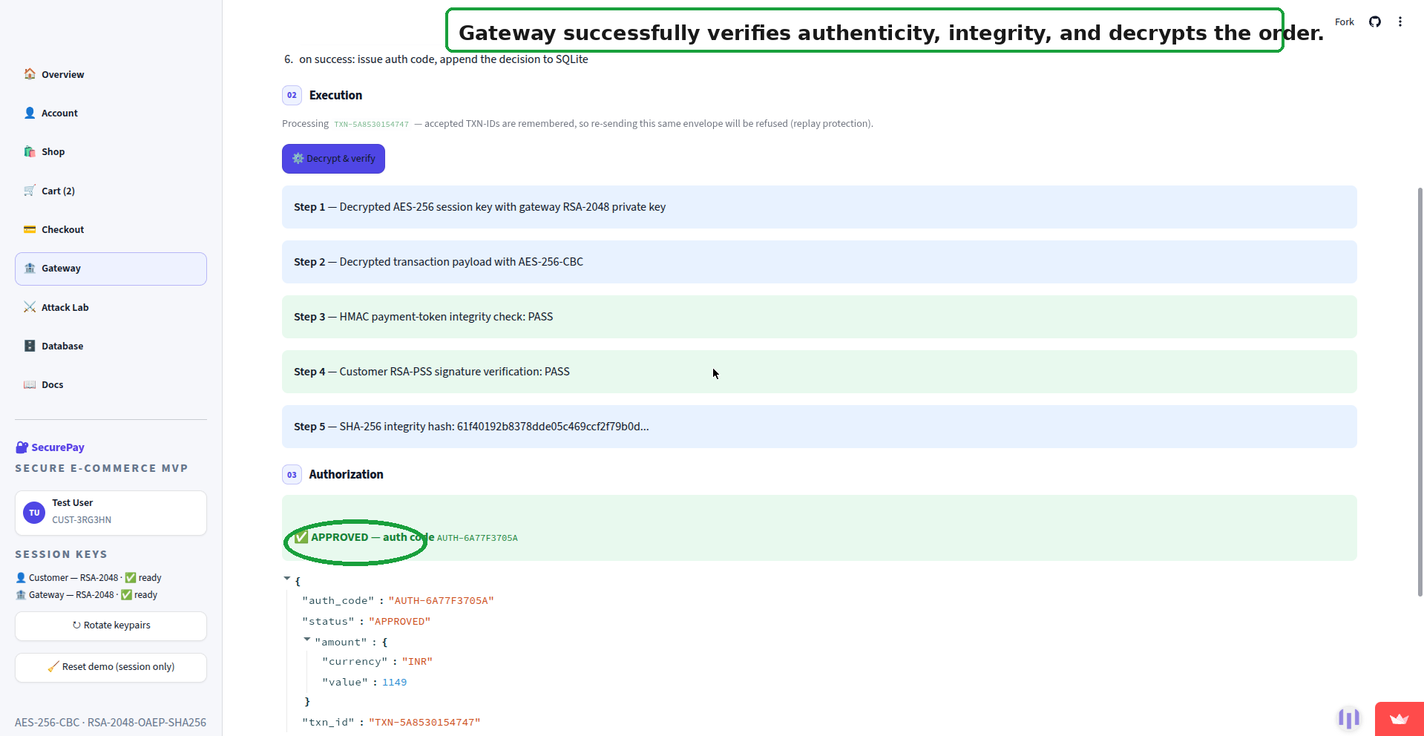
Results :End-to-End Secure Transaction

Slide 12
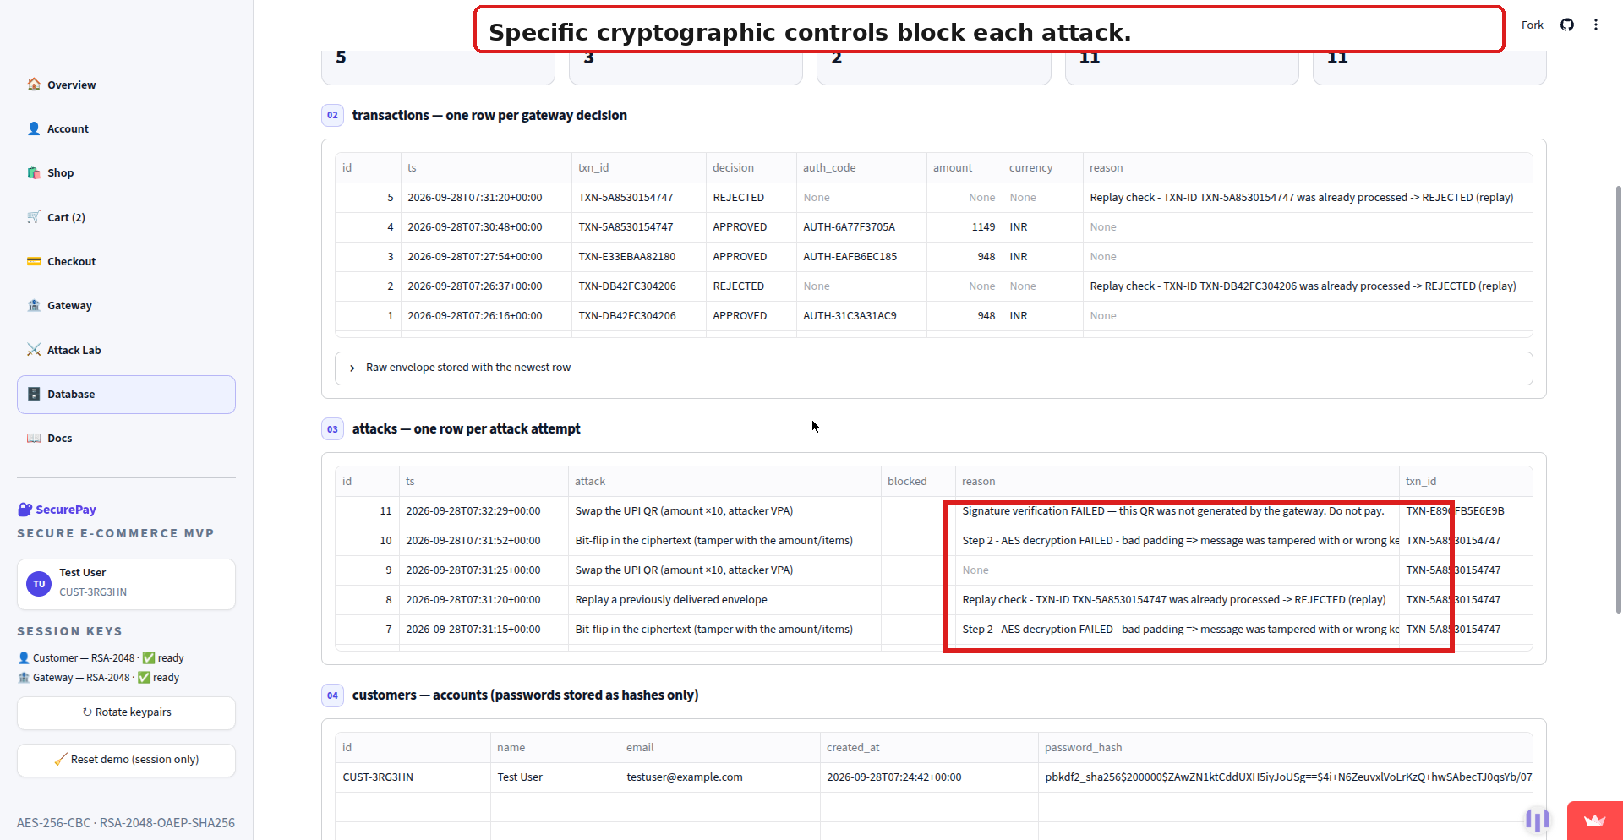
Results:Attack Lab

Slide 13
Discussion
Limitations:
Simulated Bank & UPI Rails: The issuing bank and UPI network are simulated; no real financial networks (Visa/Mastercard/NPCI) are connected.
No TLS/HTTPS: The system protects the payload (data), but not the transport channel itself. TLS is assumed to be present.
Session-Based Keys: RSA keypairs are generated per session; there is no persistent key rotation or Hardware Security Module (HSM) integration.
AES-CBC Mode: Uses AES-CBC; AES-GCM would provide authenticated encryption in a single cryptographic primitive.
Future work:
Integrate AES-GCM: Migrate to AES-GCM for authenticated encryption (eliminating the need for a separate HMAC).
Deploy behind TLS 1.3: Add end-to-end transport security for the communication channel.
Use Hardware Security Modules (HSMs): Store cryptographic keys securely in hardware rather than in memory.
Connect to a Real Payment Sandbox: Integrate with Stripe or Razorpay test mode for live validation of the payment flow.

Slide 14
Conclusion
This project set out to protect customer payment information and transaction details from cyberattacks during online shopping. Here, every transaction is digitally signed, hybrid-encrypted, and sealed with integrity checks, so that confidentiality, integrity, authenticity, non-repudiation, and replay protection all hold at the same time. Rather than simply claiming security, the project proves it: six realistic attacks, including tampering, forged signatures, replay, and UPI QR-swapping, were launched against the live system, and every one was blocked by a specific, named cryptographic control recorded in the audit trail. The implementation mirrors real production practices while honestly stating its limits, with future enhancements like AES-GCM, TLS, and hardware-protected keys already identified. Above all, the project demonstrates that strong security comes from layered, well-understood cryptography, where no single failure can ever compromise the payment.

Slide 15
References
William Stallings, Cryptography and Network Security — Principles and Practice, 8th Edition, Pearson.
NIST, FIPS 197 — Advanced Encryption Standard (AES), 2001.
NIST, FIPS 186-4 — Digital Signature Standard (DSS), 2013.
IETF, RFC 8017 — PKCS #1: RSA Cryptography Specifications Version 2.2, 2016.
PCI Security Standards Council, PCI-DSS v4.0 — Payment Card Industry Data Security Standard, 2022.
IETF, RFC 8446 — The Transport Layer Security (TLS) Protocol Version 1.3, 2018.
NIST, SP 800-38D — Recommendation for Block Cipher Modes of Operation: Galois/Counter Mode (GCM) and GMAC, 2007.
IETF, RFC 2104 — HMAC: Keyed-Hashing for Message Authentication, 1997.
IETF, RFC 2898 — PKCS #5: Password-Based Cryptography Specification Version 2.0, 2000.
Reserve Bank of India, Master Directions on Digital Payment Security Controls, 2021.

Slide 16
Thank You

